Slide 1
Social Media X
By
Jared Kraemer
Andrew Anderson
Simon Aizpurua
HelmUt

Slide 2
What Is It?
A website that allows users to get specific information from their various social media accounts.
Each different platform offers unique features for gathering and editing information
These features will allow users to perform actions that would’ve previously been impossible on the vanilla platforms

Slide 3
What Is It? (cont’d)
We have support for Twitter, Facebook, and Instagram
For the Facebook implementation, users can view specific analytics on their account
For example, being able to view the total amount of likes or posts during a certain amount of time
For Twitter, users can search for specific keywords, tweets from a certain day/time, top 5 most retweeted, etc.
For Instagram, users can delete posts before a date or posts under a user defined amount of like, etc.

Slide 4
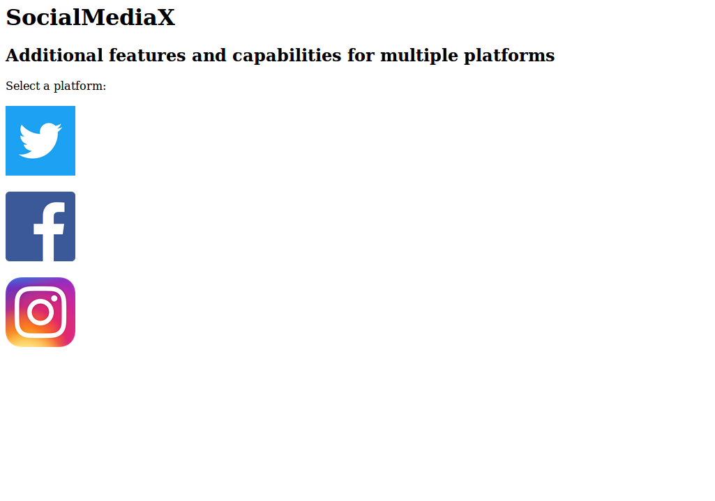
Screenshots

Slide 5
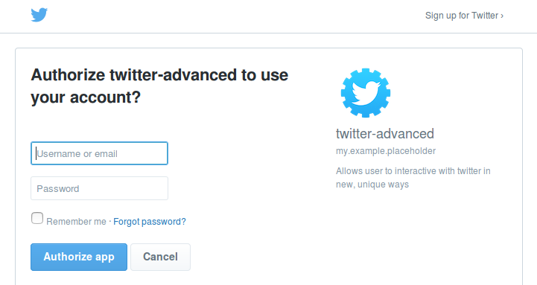
Screenshots

Slide 6

Screenshots

Slide 7
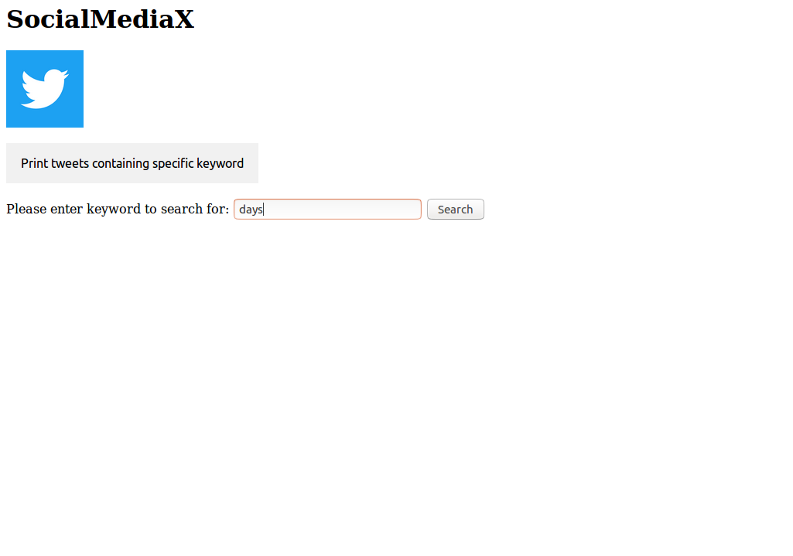
Screenshots

Slide 8
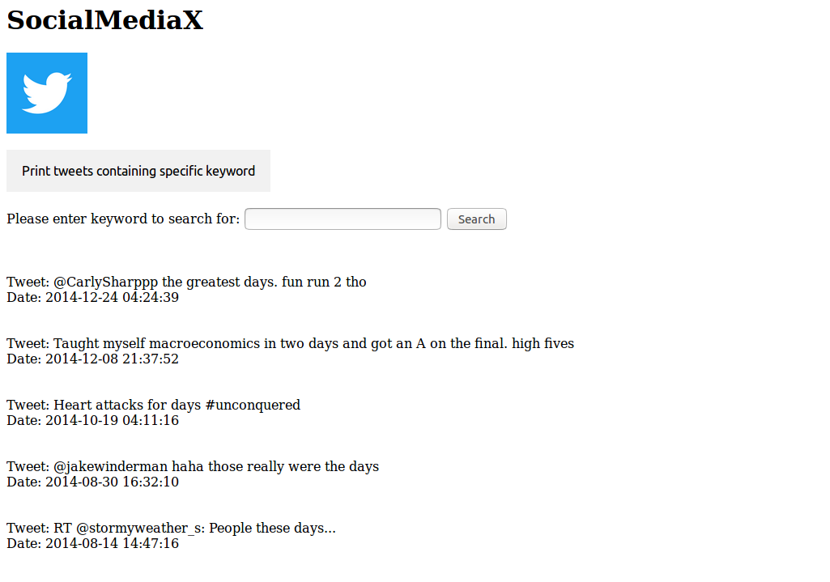
Screenshots

Slide 9
What Did We Learn
We had extensive interaction with social media APIs, which really help us develop our skills with implementing features to social media platforms
API limitations (rate limits, etc.)
Authentication
HTML
Learned the particulars of the json structure for a large social media platform

